Slide 1
Sigma Studio Integration
Dennis Kaloi
October 22, 2015
Notes:
This template can be used as a starter file for presenting training materials in a group setting.
Sections
Sections can help to organize your slides or facilitate collaboration between multiple authors. On the Home tab under Slides, click Section, and then click Add Section.
Notes
Use the Notes pane for delivery notes or to provide additional details for the audience. You can see these notes in Presenter View during your presentation.
Keep in mind the font size (important for accessibility, visibility, videotaping, and online production)
Coordinated colors
Pay particular attention to the graphs, charts, and text boxes.
Consider that attendees will print in black and white or grayscale. Run a test print to make sure your colors work when printed in pure black and white and grayscale.
Graphics, tables, and graphs
Keep it simple: If possible, use consistent, non-distracting styles and colors.
Label all graphs and tables.

Slide 2
Overview
1
3
New Sequence Commands
4
Using Sigma Studio
Real Time Programming System Setup
5
Demonstrations
What’s New
2
Notes:
Give a brief overview of the presentation. Describe the major focus of the presentation and why it is important.
Introduce each of the major topics.
To provide a road map for the audience, you can repeat this Overview slide throughout the presentation, highlighting the particular topic you will discuss next.

Slide 3
What’s New
Real Time DSP programming via Ethernet
“Cover On” programming
Connect with standard CAT5 Ethernet cable.
Software Development
Analog Devices 1953 and 1701 TCP/IP Communications Channels.
SKE Sigma TCP/IP Streaming interface added to Min-Sam and rPods.
One new Command added: “Sigma”.
DMX functionality
Compatibility with Venue Magic Show Control
Command set simplified
File format change
Real time programming over UDP Ethernet
Notes:
This is another option for an overview using transitions to advance through several slides.

Slide 4
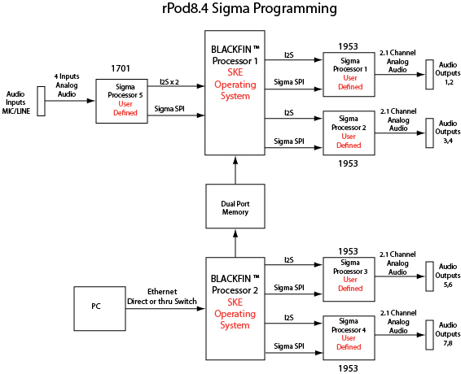
Hardware Setup Block Diagram

Slide 5
Software Setup
SKE software
Applicable versions:
8.4 rev 1.0: 074
8.4 rev 1.2: 069
MS2E: 4475
MS3E: 4495
Delete the rPod84.ini or ms2.ini file and re-boot the unit.
Sigma Studio
Version 3.12 or higher required
Install SKE provided files to SigmaStudio 3.12 folder
Compiler folder
TCPIP.dll
Setting the IP Address
rPod8.4 IP address
COM port splash screen or “Print IPADD”
Set using “Config ENET 192.168.1.5”
PC IP address
Command Prompt: IPCONFIG
Hercules: “Your PC Network Settings”
Set in Control Panel / Local Area Connection Properties/IPV4
Addresses must be different but within same domain.

Slide 6
New Sequence Commands
Sigma Command
Sigma on
Enable TCP/IP connection to Sigma Studio
Sigma off
Disables TCP/IP connection to Sigma Studio
Sigma map 1,2,3,4
Maps the Streaming Connection nodes to rPod DSP SPI connections
1953 specific. 1701 connections are differentiated by protocol.
Allows for programming of all connections with a single model.
Sigma port 8086
Sets the TCP/IP port used by Sigma Studio. 8086 is the default.
Sigma save all/1,2,3,4,5
Extracts the resident program and filter data from the specified processor and creates the new configuration files.

Slide 7
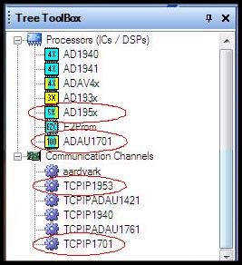
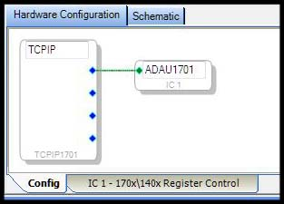
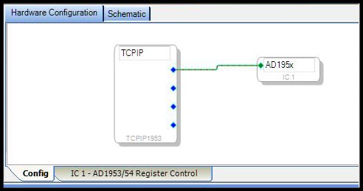
Sigma Studio DSPs and Com Channels
Notes:
This is another option for an overview slide.

Slide 8
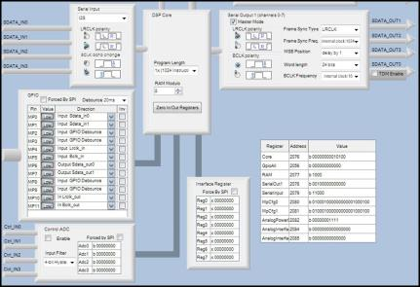
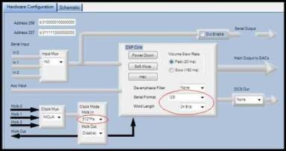
Sigma Studio Registers
1701 Register Setup
1953 Register Setup
Notes:
What will the audience be able to do after this training is complete? Briefly describe each objective and how the audience will benefit from this presentation.

Slide 9
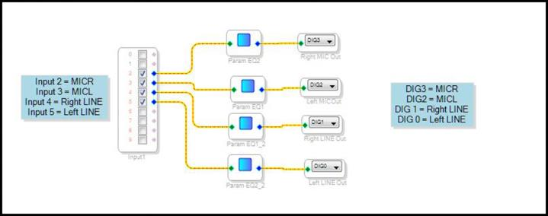
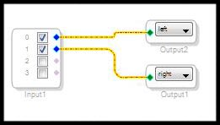
Sigma Studio I/O
1701 Mapping
1953 Mapping
Notes:
Add slides to each topic section as necessary, including slides with tables, graphs, and images.
See next section for sample table, graph, image, and video layouts.

Slide 10
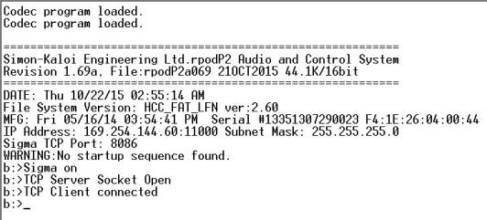
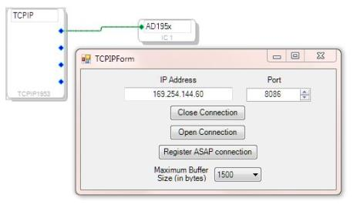
Sigma Studio Connecting
Match
Right Mouse click here to get TCPIP dialog
Set to Max
Notes:
Keep it brief. Make your text as brief as possible to maintain a larger font size.

Slide 11
Questions?

